Slide 1
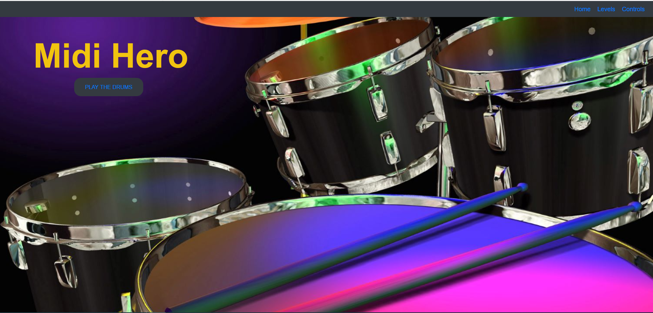
Creators: James, Brad, Firoz

Slide 2
Mean while at 12:30 am……

Slide 3
CONCEPT AND MOTIVATION OF OUR PROJECT
Midi Hero is a browser based game that takes you into the world of DDR (Dance Dance Revolution) but without the dancing….just playing the drums!
The main hero of this game is the introduction of MIDI (Musical Instrument Digital Interface) files.
Wanting to create a music based application DDR came to conversation and this was the basis for the game.

Slide 4
PROJECT CRITERIA
​
Use a Node and Express Web Server;
Be backed by a MySQL Database an ORM (not necessarily Sequelize);
Have both GET and POST routes for retrieving and adding new data;
​
Be deployed using Heroku (with Data);
Utilize at least one new library, package, or technology that we haven’t discussed;
Have a polished frontend / UI;
Have folder structure that meets MVC Paradigm;
Meet good quality coding standards (indentation, scoping, naming).
Must not expose sensitive API key information on the server.

Slide 5
DRUM ROLL PLEASE….. https://midi-ddr.herokuapp.com/

